Slide 1

Object-Oriented Programming Discussion, Lecture, & Lab Eric Pogue
Friday, November 8th from 2 to 2:50pm CST:
Friendly Conversation Topic – Kubernetes & Swarm
Assignment from Last Class
SwissArmyKnife Demos
Assignment for Next Class
Lab
Discussion & Questions welcome at any time… please be present with no phones or email during our time together

Slide 2
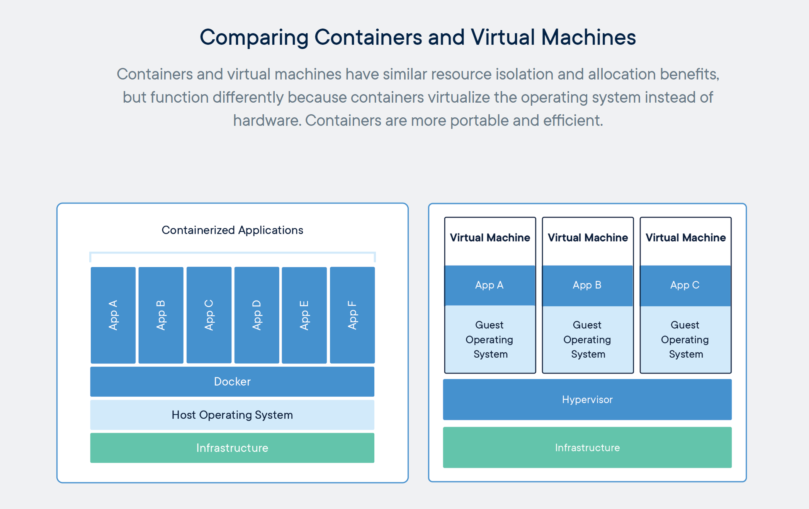
Recall Containers & Docker [link]

Slide 3
Kubernetes & Swarm [link]

Slide 4
Assignment
Complete 6 activities list items [link] through item 4
Final Project Proposal
Friday Discussion Board (as needed)

Slide 5
Blackboard Grading Comments

Slide 6
SwissArmyKnife Demos

Slide 7
Assignment
Complete 6 activities list items [link] through item 8
Submit Demo Assignment (if you have completed your demo)
Submit Discussion Board 6

Slide 8
Lab
As A Scrum Team:
Review Announcement & Verify Index URL
Submit Demo Assignment (if you have completed your demo)
Submit Discussion Board 6
Refresh ExampleCode
Work on SwissArmyKnife v2 and/or SleepFast
Report out at 2:46
Team Report Out Guidelines
Scrum Master will stand up, give your name, your team name, and briefly answer the following questions:
What did you accomplish since the last meeting? And what will you be working on until the next meeting?
Is the team committed to completing assignments? All/Most/Some
What is getting in your way or keeping you from completing the assignments?

Slide 9
Review Announcement & Verify Index URL

Slide 10
Demo Assignment Complete

Slide 11
Recall Demo Assignment

Slide 12
Demo Assignment Complete

Slide 13
Submit Discussion Board 6

Slide 14
End of Session

